Slide 1
Agenda
Introductions & What’s New in Azure Databricks
Modern Data Architecture with Azure Databricks & Synapse
Delta Demo & Code Along (Notebooks in https://academy.databricks.com/class/register)
Competitive Plays & Positioning
Break (~15min)
Machine Learning With Azure Databricks
Machine Learning Demo & Code Along (Notebooks in https://academy.databricks.com/class/register)
Hadoop Migrations & Vertical Plays
Wrap Up & Capstone

Slide 2
Choosing the Right Tools
in a Modern Data Architecture

Slide 3
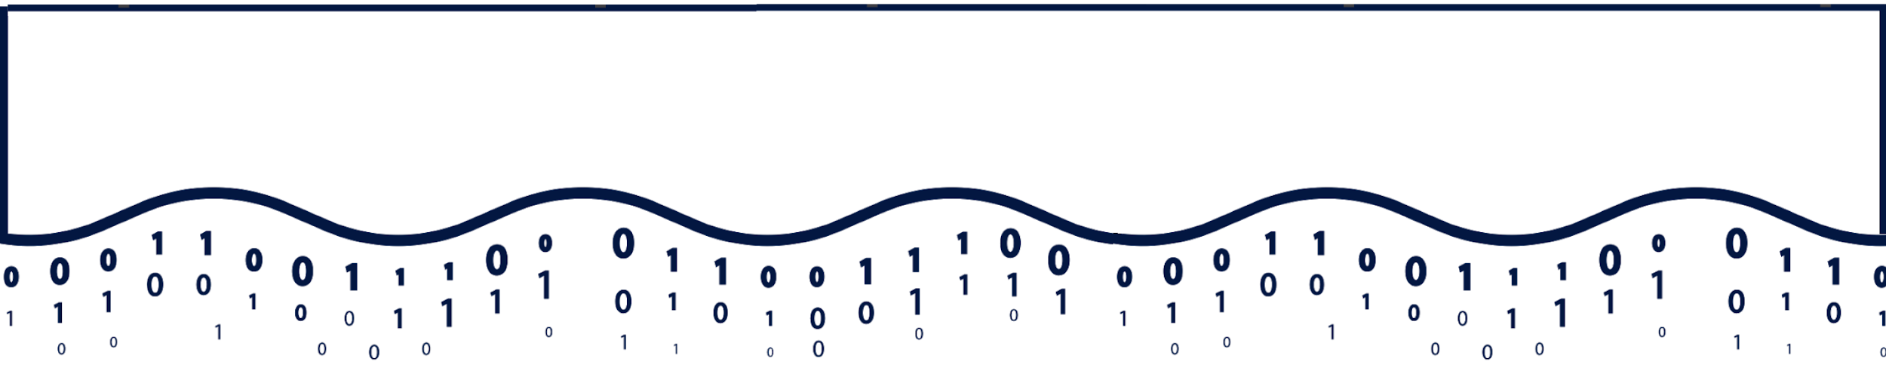
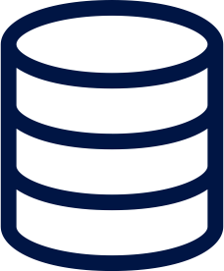




Building a Modern Data Architecture
Big Data Engineering
Streaming
Data Science and Machine Learning
SQL Analytics
and BI
Reporting and dashboards
Curated Data
Data Lake
Raw Data
Structured
Semi-Structured
Unstructured Data

Slide 4


Data Lake with Best-in-Class, Open Standards
Big Data Engineering
Streaming
Data Science and Machine Learning
SQL Analytics
and BI
Reporting and dashboards
Curated Data
ADLS G2
Raw Data
Structured
Semi-Structured
Unstructured Data

Slide 5
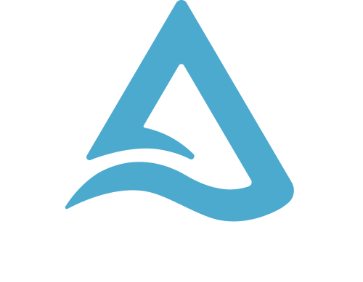
Open Format Based on Parquet
With Transactions
Apache Spark API’s
A New Standard for Building Data Lakes

Slide 6
Delta Lake ensures data reliability
Batch
Parquet Files
High Quality & Reliable Data always ready for analytics
Streaming
Updates/Deletes
Transactional Log
ACID Transactions
Schema Enforcement
Unified Batch & Streaming
Time Travel/Data Snapshots
Key Features

Slide 7

Delta Lake optimizes performance
Databricks optimized engine
Highly Performant
queries at scale
Parquet Files
Transactional Log
Indexing
Compaction
Data skipping
Caching
Key Features

Slide 8
Data Lake with Best-in-Class, Open Standards
Big Data Engineering
Streaming
Data Science and Machine Learning
SQL Analytics
and BI
Reporting and dashboards
Curated Data
ADLS G2
Raw Data
Structured
Semi-Structured
Unstructured Data

Slide 9








Open Data Lake means Flexibility in Tools and Services
Azure Databricks
Azure Synapse Analytics
Azure Data Factory
Azure Machine Learning
Azure Stream Analytics
Azure HDInsight
Power BI
Curated Data
ADLS G2
Raw Data
Structured
Semi-Structured
Unstructured Data

Slide 10
Choosing the Right Tool for the Job
Big Data Engineering
Streaming
Data Science and Machine Learning
SQL Analytics
and BI
No/Low Code Pipelines
Reporting and dashboards
Curated Data
ADLS G2
Raw Data
Structured
Semi-Structured
Unstructured Data

Slide 11
Reduce the Architecture Complexity
Big Data Engineering
Streaming
Data Science and Machine Learning
SQL Analytics
and BI
No/Low Code Pipelines
Reporting and dashboards
Curated Data
ADLS G2
Raw Data
Structured
Semi-Structured
Unstructured Data

Slide 12
Simple, Best-in-Class Architecture
Big Data Engineering, Streaming. Data Science and Machine Learning
SQL Analytics, BI, No/Low Code Pipelines
Reporting and dashboards
Curated Data
ADLS G2
Raw Data
Structured
Semi-Structured
Unstructured Data

Slide 13
Azure Databricks, Synapse Integration
Synapse Spark Connector (Docs)
Optimized connector for reading data from and writing data to Azure Synapse
DBR 7.0+ supports Synapse COPY command
Supports streaming
Delta Lake Support
Azure Databricks and Synapse Spark (Docs) support Delta Lake
Mapping Data Flows in ADF supports Delta Lake (Docs), which enabled easy copy from Delta Lake into Synapse via ADF.
Synapse Pipelines
Synapse Pipelines can execute Azure Databricks Notebooks, JARs, and Py files (Docs)

Slide 14
Case Studies

Slide 15

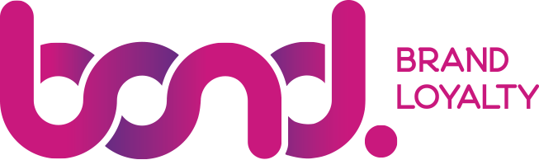

Bond Brand Loyalty accelerated reporting from 1 month to 4 hours with Azure Databricks Delta Lake
Bond Brand Loyalty works with some of the world’s most influential and valuable brands. Recognized by Forrester, Gartner, and Loyalty 360 as a market leader, Bond has expertise in human and digital experience design.
Bond uses Azure Databricks Delta Lake to provide near real-time reporting for customers. Azure Data Factory is used to move data from on-premises sources to Delta Lake, where it is processed using Azure Databricks.
“Azure Databricks has unlocked a new world and using data in a new way. It opens the door to a future of ML with no data latency, delivering results in near real-time,” explained Sarah Willock, Manager of Digital Development at Bond. “We are already seeing efficiencies and our data reporting pipeline is much easier to maintain and far more reliable.”
Azure Databricks
Azure Data Factory
Azure Analytics Services
Azure Synapse Data Warehouse
Azure Power BI
Location
500
Marketing Consulting
Toronto, Canada
Notes:
Bond Brand Loyalty provides customer experience and loyalty solutions for some of the world’s most influential and valuable brands across a wide variety of industry verticals, from banking and auto manufacturing, to entertainment and retail. For Bond, protecting customer data is a top priority, so security and encryption are always top of mind. Bond is constantly innovating to accelerate and optimize their solutions and the client experience. Bond provides customers with regular reporting to help them see their brand performance. They needed to improve reporting speed from weeks to hours.
Bond wanted to augment its reporting with data from third-party sources. Due to the size of the data, it did not make sense to store the information in a transactional database. The Bond team investigated the concept of moving to a data lake architecture with Delta Lake to support advanced analytics. The team began to gather data from different sources, landing it in the data lake and staging it through each phase of data processing. Using Azure Databricks, Bond was able to leverage that rich data, serving up more powerful, near real-time reports to customers. Instead of the typical pre-canned reports that took a month to produce, Bond is now able to provide more flexible reporting every 4 hours.
Going from monthly reports to fresh reports every 4 hours has enabled new efficiencies. Bond used to have warehouses, reporting cubes, disaster recovery, and infrastructure to support the old world. Now, with Azure Databricks, Bond has observed that its data pipelines and reporting are much easier to maintain. ETL pipelines that previously took 18 hours to run on-premises with SSIS can now be run in as little as 5 minutes. As a byproduct of the transition to a modern, simplified architecture, Bond was able to reduce pipeline creation activities from two weeks down to about two days.
With Azure Databricks and Delta Lake, Bond now has the ability to innovate faster. The company is augmenting its data with Machine Learning (ML) predictions, to orchestrate campaigns, and enable deeper campaign personalization so clients can provide more relevant offers to their customers. Thanks to Azure Databricks, Bond can easily scale its data processing and analytics to support rapid business growth.
https://databricks.com/blog/2020/08/18/how-to-accelerate-your-etl-pipelines-from-18-hours-to-as-fast-as-5-minutes-with-azure-databricks.html

Slide 16
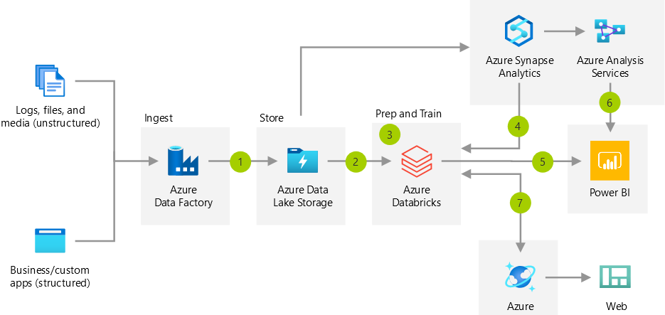
Bond Brand Loyalty architecture
Flexible reporting every 4 hours
Deeper campaign personalization
Pipeline creation went from 2 weeks down to 2 days
Data lake architecture with Delta Lake
Notes:
Advanced Analytics Architecture
https://docs.microsoft.com/en-us/azure/architecture/solution-ideas/articles/advanced-analytics-on-big-data
Blog post: https://databricks.com/blog/2020/08/18/how-to-accelerate-your-etl-pipelines-from-18-hours-to-as-fast-as-5-minutes-with-azure-databricks.html

Slide 17
Open Discussion and Q&A

Slide 18
Appendix

Slide 19
Why use Azure Databricks?
Make Data Engineers More Effective
Make Data Scientists More Effective
Make Compute More Effective
Single, open, consistent way to do ETL and streaming
BYO IDEs and tools
Reliable APIs, CLIs, and other interfaces
DevOps Integration
Comprehensive library management
Collaborative Data Science Workspace
ML Runtime with pre-installed, optimized libraries
Open, Consistent tracking and deployment with MLFlow
HyperOpt, AutoML
30%-500% faster than OSS Spark
Always the latest, greatest Spark
Query-load-based autoscaling
Ephemeral jobs clusters
Unparalleled Expertise

Slide 20
Optional - Delta 101

Slide 21
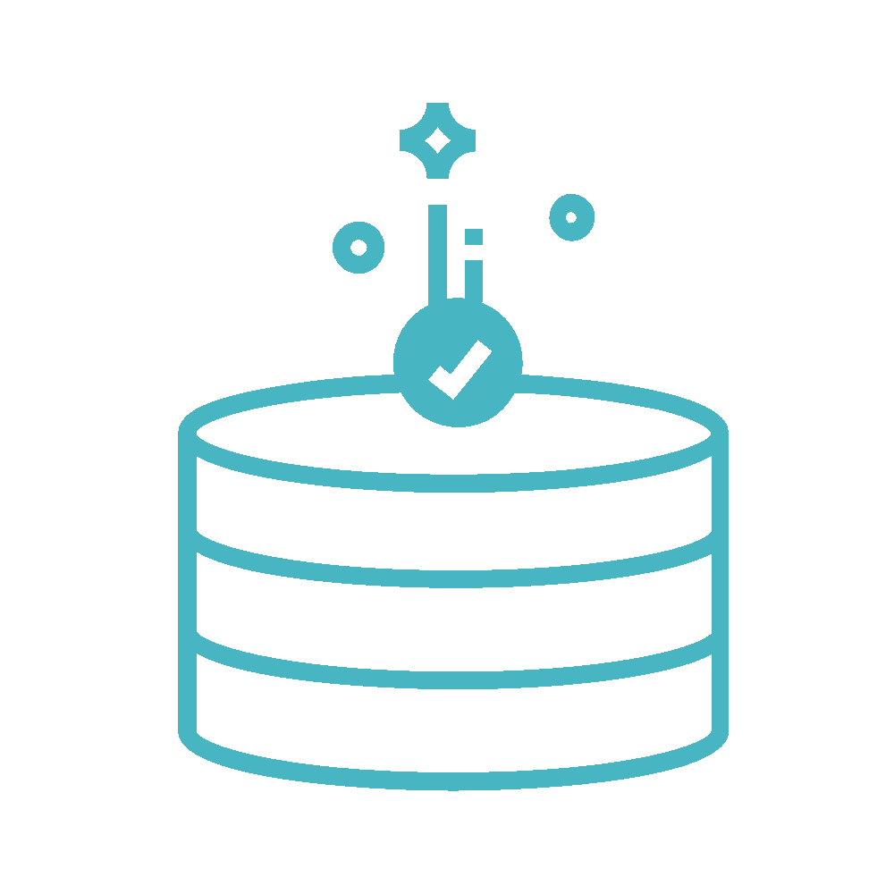

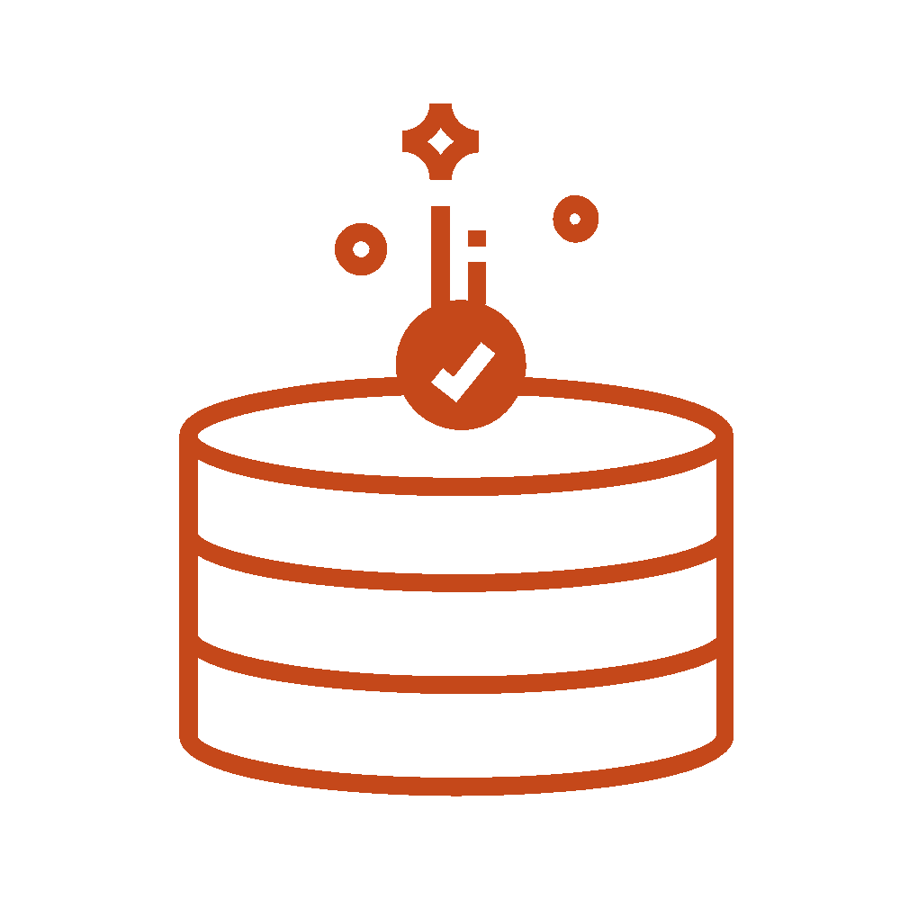
Data reliability challenges with data lakes
Failed production jobs leave data in corrupt state requiring tedious recovery
✗
Lack of schema enforcement creates inconsistent and low quality data
Lack of consistency makes it almost impossible to mix appends and reads, batch and streaming

Slide 22

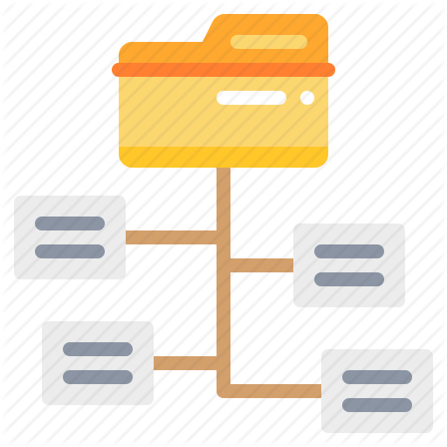
Performance challenges with data lakes
Too many small or very big files - more time opening & closing files rather than reading contents (worse with streaming).
Partitioning aka “poor man’s indexing”- breaks down if you picked the wrong fields or when data has many dimensions, high cardinality columns.
No caching - cloud storage throughput is low (cloud object storage is 20-50MB/s/core vs 300MB/s/core for local SSDs).
Notes:
Too many small files: jobs spent most of the time opening and closing files, rather than reading the contents of the files.
Caching: Cloud storage throughput is low (S3 is 20 to 50MB/s/core, vs 300MB/s/core for local NVMe SSDs)
Indexing:
People have been using partiitoning as poor man’s indexing for a long time
partiioning breaks down:
multiple dimensions
high cardinality columns (date is fine, but user id or ip address is not)
floating point values (decimal, floating point, e.g. “cost”, “price”, “revenue”)

Slide 23
Open Format Based on Parquet
With Transactions
Apache Spark API’s
A New Standard for Building Data Lakes

Slide 24
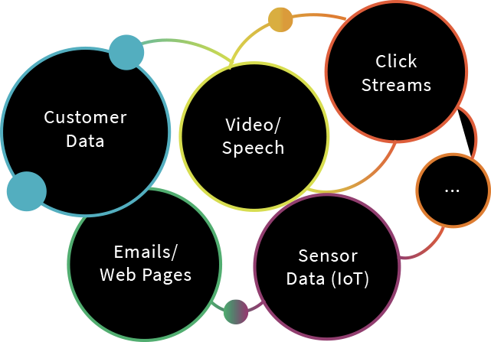
Delta Lake: makes data ready for analytics
Data Science & ML
Reliability
Performance
Recommendation Engines
Risk, Fraud Detection
IoT & Predictive Maintenance
Genomics & DNA Sequencing

Slide 25
Delta Lake ensures data reliability
Batch
Parquet Files
High Quality & Reliable Data always ready for analytics
Streaming
Updates/Deletes
Transactional Log
ACID Transactions
Schema Enforcement
Unified Batch & Streaming
Time Travel/Data Snapshots
Key Features

Slide 26
Delta Lake optimizes performance
Databricks optimized engine
Highly Performant
queries at scale
Parquet Files
Transactional Log
Indexing
Compaction
Data skipping
Caching
Key Features

Slide 27
Get Started with Delta using Spark APIs
Instead of parquet...
… simply say delta
CREATE TABLE ...
USING parquet
...
dataframe
.write
.format("parquet")
.save("/data")
CREATE TABLE ...
USING delta
…
dataframe
.write
.format("delta")
.save("/data")

